Slide 1

EVENT IT! AN EVENT REPOSITORY

Slide 2
VISION
To create a Web Application EventIt which:
is an event repository that helps people to find events,
serves as a platform for hosts to promote the free events,
provides interface for users to register for an event by reserving tickets

Slide 3
OVERVIEW
The following functionalities are included in the system:
Provides a platform to create events and promote them on website
Helps people to get to know the various events taking place
Allows users to browse the events based on different categories
Provides login to users to host or to register for events
Allows users to reserve tickets for events based on the availability
Allows the event hosts to update or delete events
Allows users who have reserved tickets to rate the events once the event has happened
Ensures that notifications are sent for every update
Eliminates any inappropriate content present

Slide 4
Users of the system
Admin
Registered user
General user
Notes:
There are 3 main users in our system
Admin:
Admin is responsible for the credibility of the events being published on the website. Whenever a registered user creates an event, an event request is sent to the admin for approval, to check the authenticity of the event and its host, before being published on the site. This prevents the creation of fraudulent events on the site.
Registered Users:
Registered users are the users who have signed up for the website. These users have the privilege to create their events and promote them after the event is approved by the admin. They can also edit the event details or delete the event. Not only that, but they can also reserve slots for the events they wish to attend, which are hosted by other users. They will also have permission to rate the events they have attended.
General Users:
General users are the other users who visit the website. They can browse events based on different event types and look into the details but they will not be able to reserve their slots unless they sign up.

Slide 5
Iteration 1 – Project Scope
Creating the events and submitting it for approval.
Management of worklist by the admin to approve or reject the event publish request.
Browsing the events that are approved by the admin and published on the web site

Slide 6
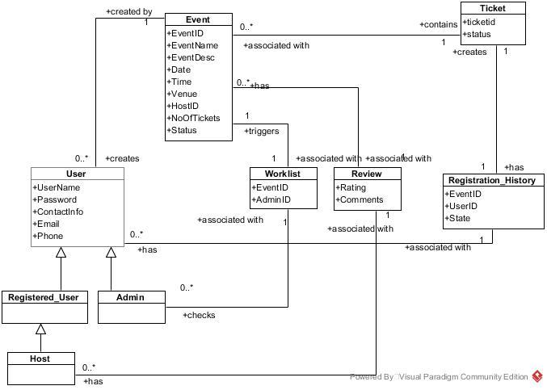
Domain Model

Slide 7
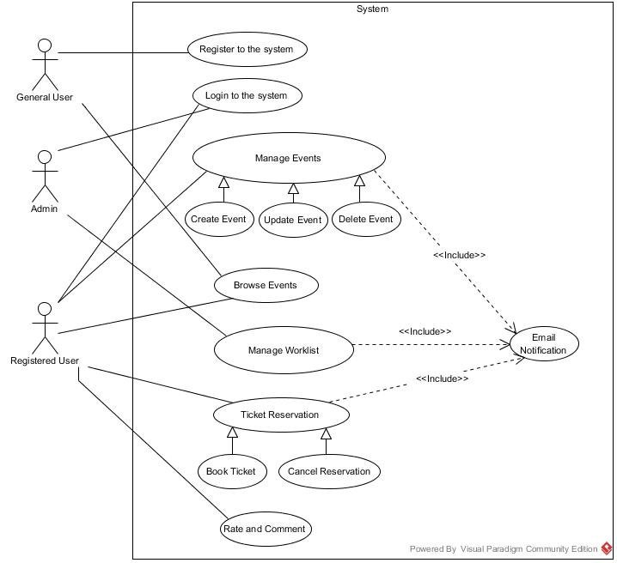
Use Case Diagram

Slide 8
USE CASES
USE CASE UC1: CREATE EVENTS
USE CASE UC2: MANAGE WORKLIST
USE CASE UC3: BROWSE EVENTS

Slide 9
USE CASE TEXT

Slide 10
USE CASE UC1: CREATE EVENTS
Scope: EventIt application
Level: User goals
Primary Actor: Registered user
Stakeholders and Interests:
Registered user: Wants to create and promote their events. They also want to know about the upcoming events and book tickets.
General user: They can know about the events happening.
Preconditions: User is registered to the system with a username and password.
Post conditions: An event is created and a publish request is sent to the admin for approval.

Slide 11
Main Success Scenario (Basic Flow)
Login to the system using username and password.
Click on create events to retrieve the event creation form.
Enter the event details such as event name, description, date, time, venue, total number of tickets in the event creation form.
Click on submit to send event publish request to the admin.
Send email notification to the admin about the event publish request and update the admin worklist.
Send email confirmation to the user saying that a publish request has been sent to the admin and will be notified once a decision is made.

Slide 12
Extensions (or Alternative Flows)
If the event name given is already present. Prompt the message to the user about the duplicate event name.
a. If the user still wants to go with the same event name, then submit the publish request to the admin.
b. If the user decides to change the event name given, then do not submit the publish request.
If the admin creates an event and clicks on submit.
The event is auto approved by the system and it is published on the site so that it can be browsed by other users visiting the website.

Slide 13
USE CASE UC2: MANAGE WORKLIST
Scope: EventIt application
Level: User goals
Primary Actor: Admin
Stakeholders and Interests:
Registered user: Wants to create and promote their events. They also want to know about the upcoming events and book tickets.
General user: They can know about the events happening.
Preconditions: events are created by the registered users and event publish request is submitted.
Post conditions: Event will be published on the site once it is approved by the admin and the user is notified about the approval.

Slide 14
Main Success Scenario (Basic Flow)
Log in to the system using admin username and password.
Click on worklist to get the list of all event publish requests to be approved.
Click on the event to be approved to get the event details.
Go through the event details and approve the event by clicking “Approve Event”.
Send email notification to the user about the event approval.
Publish the event on the site so that it can be browsed by other users visiting the website.

Slide 15
Extensions (or Alternative Flows)
Admin goes through the event details and reject the event by clicking “Reject Event”.
Send email notification to the user about the rejection of their event publish request.
Do not Publish the event on the site.

Slide 16
USE CASE UC3: BROWSE EVENTS
Scope: EventIt application
Level: User goals
Primary Actor: General user, Registered user
Stakeholders and Interests:
Registered user: Wants to create and promote their events. They also want to know about the upcoming events and book tickets.
General user: They can know about the events happening.
Preconditions: events are created by the registered users, approved by the admin and is published on the site.
Post conditions: List of all upcoming events is retrieved.

Slide 17
Main Success Scenario (Basic Flow)
Visit the web site and click on browse events.
Retrieve the list of all upcoming events and display it to the user.
Click on the event of your interest.
The event page is retrieved with the event details.

Slide 18
Extensions (or Alternative Flows)
If the list of upcoming events retrieved has no events.
Display the message “No Upcoming events”.

Slide 19
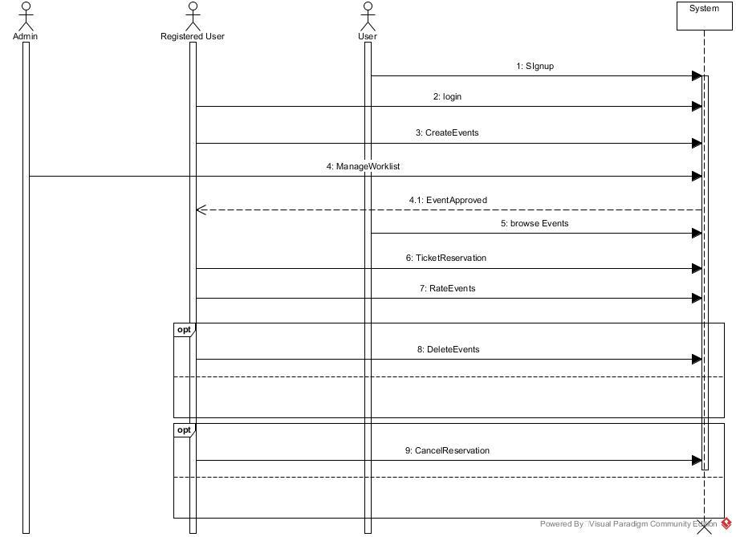
SYSTEM SEQUENCE DIAGRAM

Slide 20
INTERACTION DIAGRAMS

Slide 21
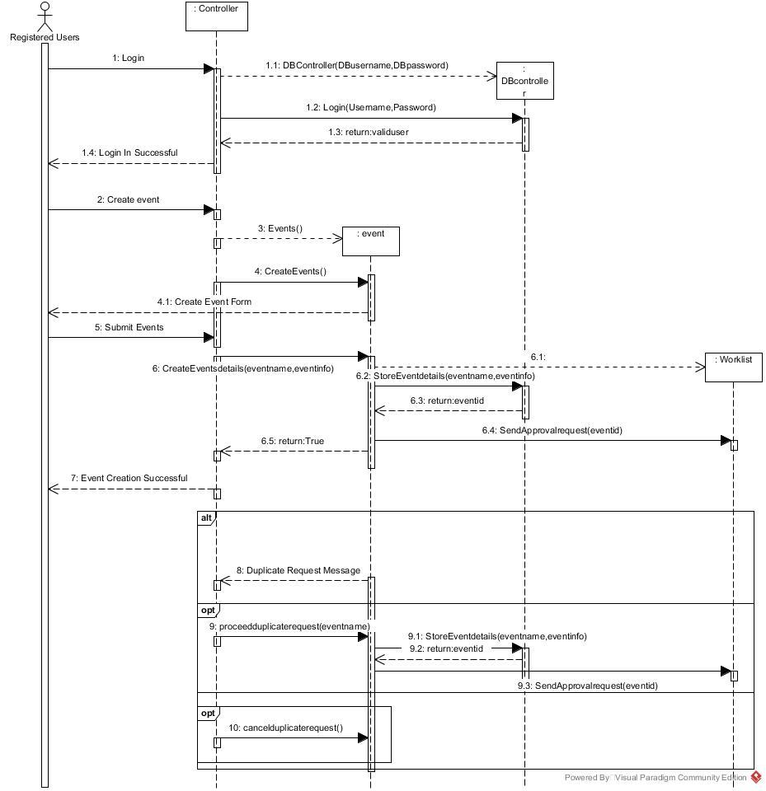
CREATE EVENT

Slide 22
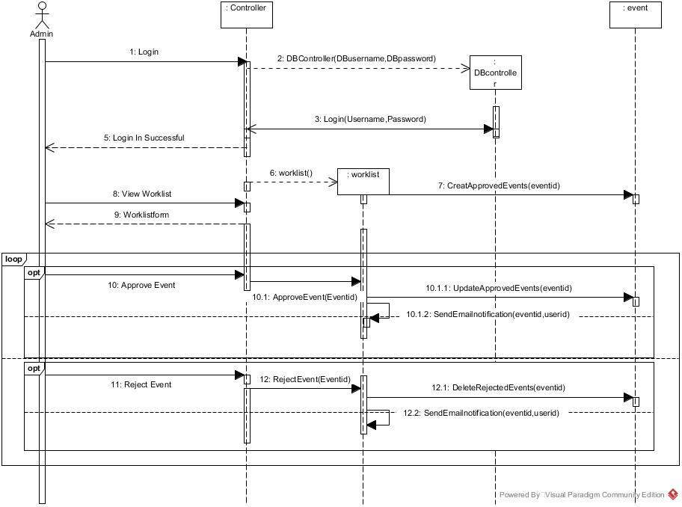
MANAGE WORKLIST

Slide 23
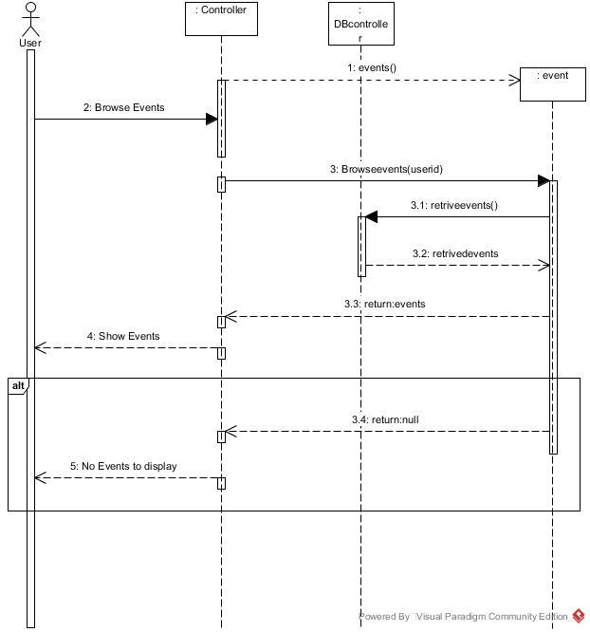
BROWSE EVENTS

Slide 24
Operation Contract

Slide 25
CONTRACT 1

Slide 26
CONTRACT 2

Slide 27
UI SCREENSHOTS

Slide 28
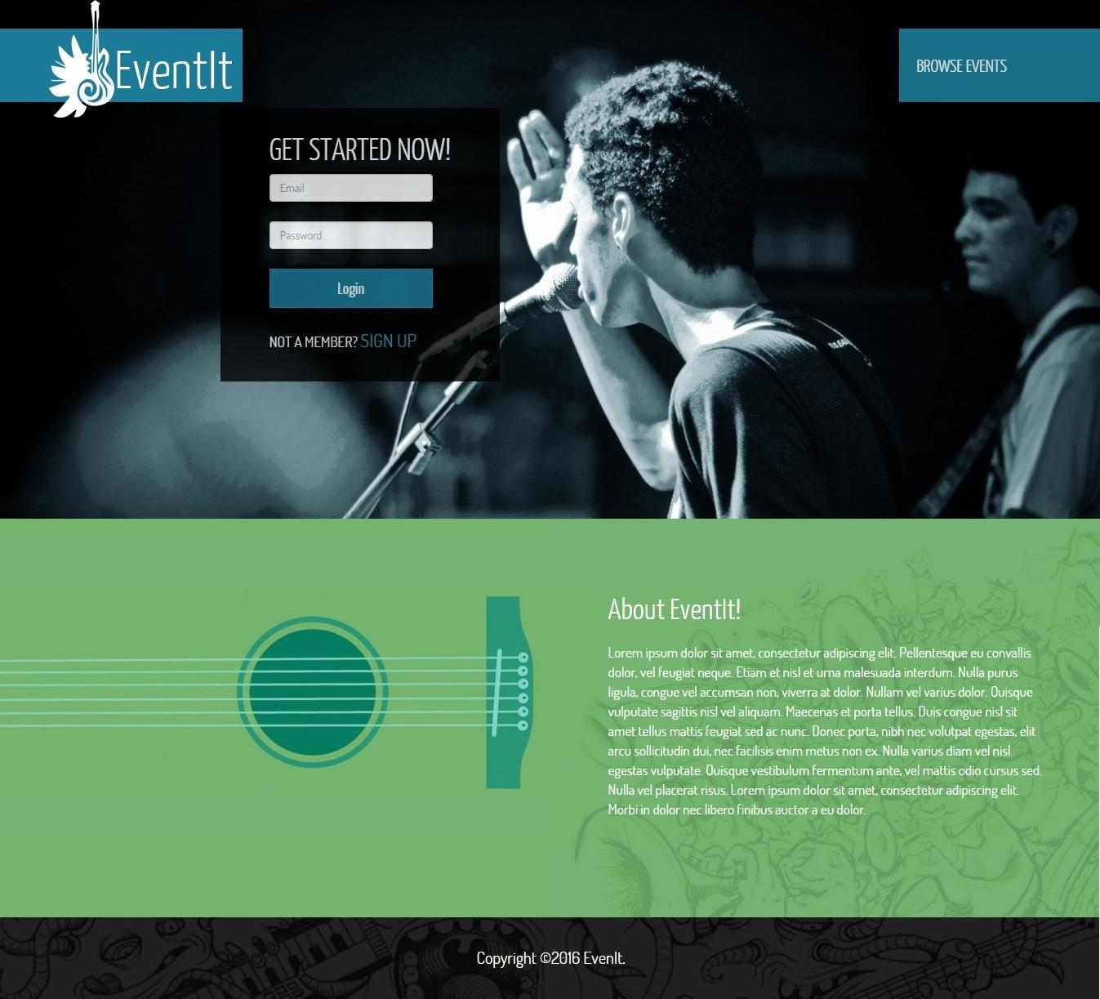
Login Page

Slide 29
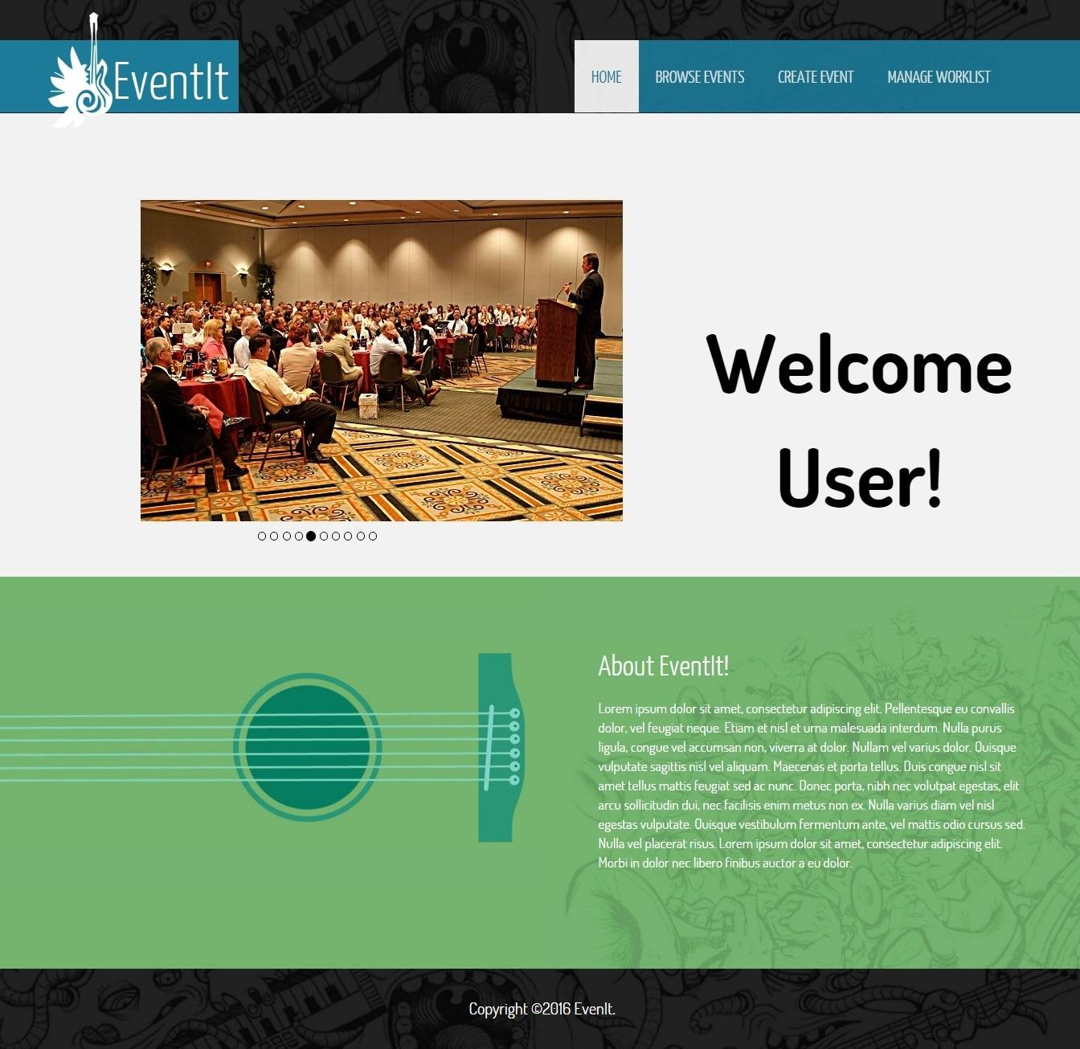
Home Page

Slide 30
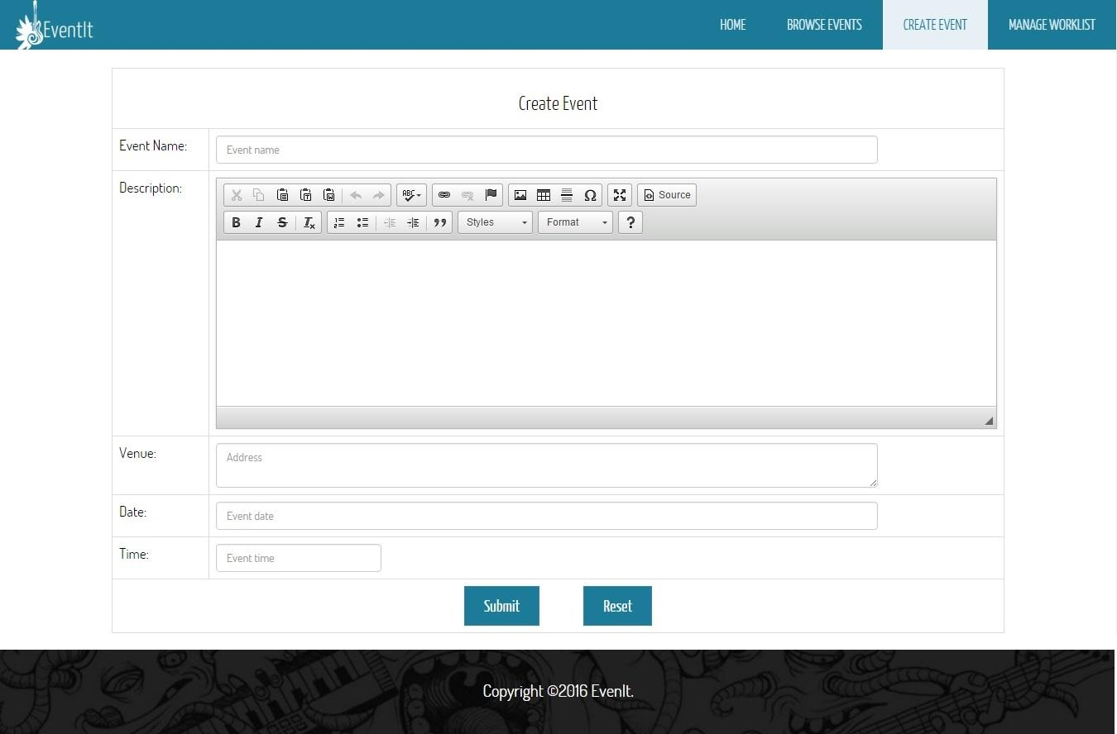
Create Event

Slide 31
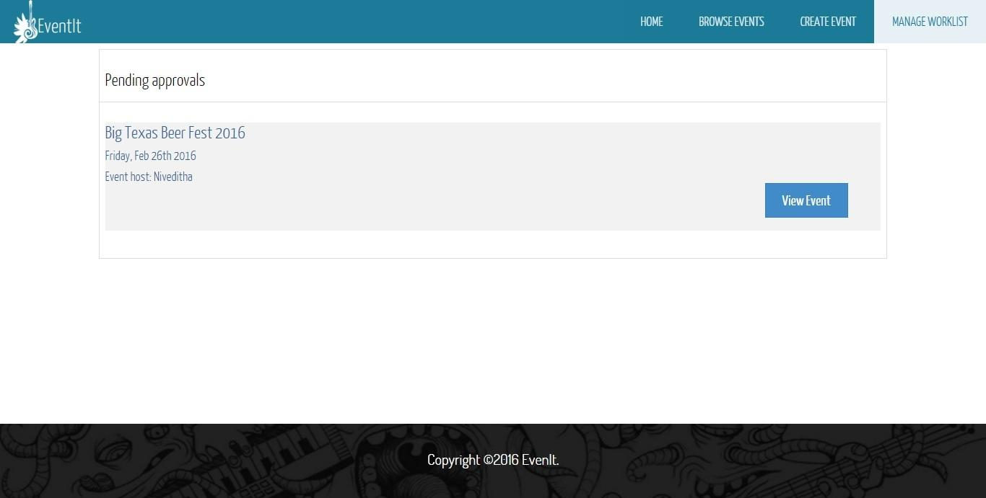
Manage Worklist

Slide 32
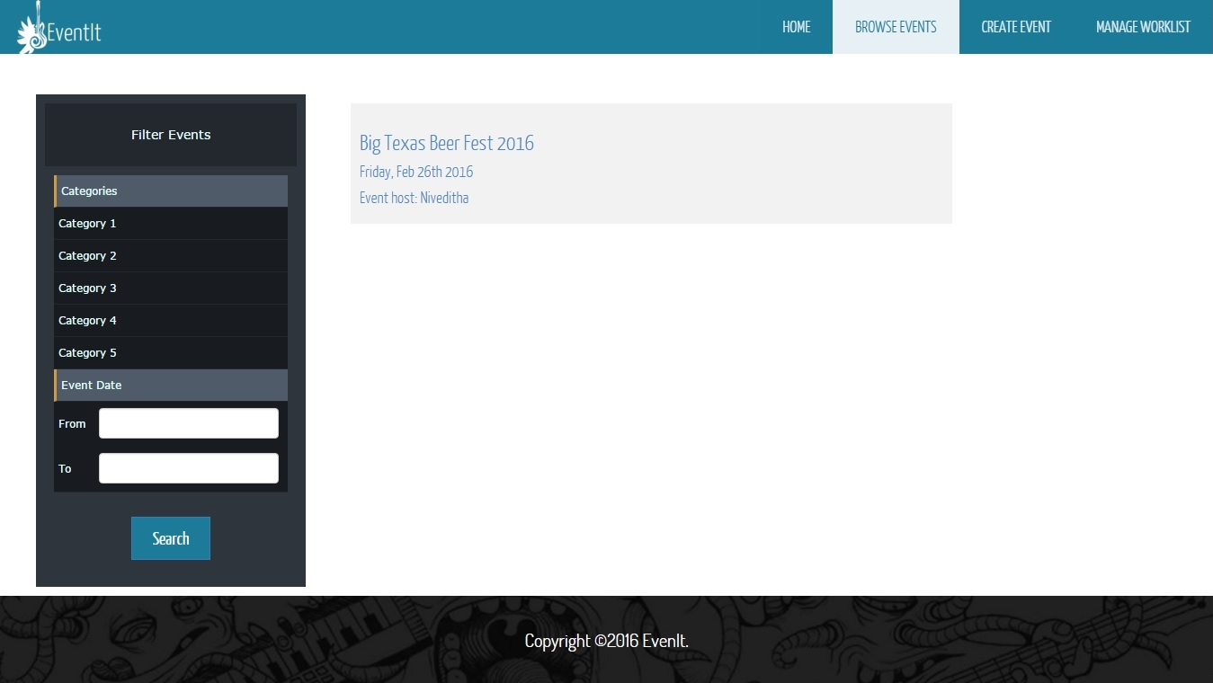
Browse Event

Slide 33
PLAN FOR ITERATION-II
Requirement analysis
Ticket reservation module
Cancel ticket reservation module
Update event module
Delete event module
Refine the system
Documentation and Report
Backlogs from iteration 1

Slide 34


